Slide 1


<Albin Bergström>
<21-09-2023>

Slide 2

Outline
Executive Summary
Introduction
Methodology
Results
Conclusion
Appendix

Slide 3
Executive Summary
Summary of methodologies
Data Collection through API
Data Collection with Web Scraping
Data Wrangling
Exploratory Data Analysis with SQL
Exploratory Data Analysis with Data Visualization
Interactive Visual Analytics with Folium
Machine Learning Prediction
Summary of all results
Exploratory Data Analysis result
Interactive analytics in screenshots
Predictive Analytics result

Slide 4
Introduction
Project background and context
Space X advertises the Falcon 9 rocket launch as a 62 million dollars project while other providers have costs north of 165 million dollars. The cause for Space X having considerably lower expenditures is explained by their ability to reuse the first stage of launching. By extension, if we are able to determine whether the first stage will land successfully, we can determine the cost of an individual launch. This knowledge can be relevant for a multitude of aspects such as competitiveness, launch-bid considerations and investment feasibility. Therefore the goal of this project is to create a machine learning pipeline to predict whether the first stage will land successfully or not.
Problems you want to find answers
What variables influence whether the rocket will land successfully?
Is there any interaction between specific variables that seemingly moderate the success rate of a successful landing?
What operating conditions needs to be in place to ensure a successful landing program?

Slide 5

Section 1

Slide 6
Methodology
Executive Summary
Data collection methodology:
Data was collected using SpaceX API and web scraping from Wikipedia.
Perform data wrangling
One-hot encoding was applied to categorical features
Perform exploratory data analysis (EDA) using visualization and SQL
Visualizing the data to better represent the findings
Perform interactive visual analytics using Folium and Plotly Dash
Highlighting proximity to relevant infrastructure to project locations
Perform predictive analysis using classification models
How to build, tune, evaluate classification models

Slide 7
Data Collection
The data was collected using a variety of methods
Data collection was done using a GET request to the SpaceX API.
Tthe response content was decoded as a Json using .json() function call and then turned into a pandas dataframe using .json_normalize().
The data was cleaned, checked for missing values and replaced any missing values with for example, mean averages.
Additionally, we performed a web scraping from Wikipedia for Falcon 9 launch records with BeautifullSoup.
Finally we extracted the launch records as a HTML table, parsed the table and convert it to a pandas dataframe for future analysis.

Slide 8
Data Collection – SpaceX API
We utilized a GET request to retrieve our intended data.
Subsequently we transformed the JSON result into a dataframe to further work or clean the data if required.
As expected, the data required cleaning and we simply replaced missing numerical values with the aggregated mean of the column to ensure we retain
Reference: https://github.com/BIM-Master/Space_x_IBM/blob/main/jupyter-labs-spacex-data-collection-api.ipynb
Retrieve Launch Data through API by utilizing get a GET Request
Subsequently we utilized json_normalize to transform the requested JSON result into a dataframe
Finally, we cleaned the data, and replaced missing values with mean calculations

Slide 9
Data Collection - Scraping
We scrapped the Falcon 9 Rocket data through a HTTP Get Request
Afterwards we utilized BeautifullSoup to subsequently extract column and variable names from the header
Finally we integrate it into a new dataframe
Reference: https://github.com/BIM-Master/Space_x_IBM/blob/main/jupyter-labs-webscraping.ipynb
Retrieve Falcon 9 Rocket Launch Page with a HTTP Get Request method
Generate a BeautifullSoup Object from the HTML response
Retrieve Column names by iterating through the BeautifullSoup Object

Slide 10

Data Wrangling
We performed exploratory data analysis and determined the training labels.
We calculated the number of launches at each site, and the number and occurrence of each orbits
We created landing outcome label from outcome column and exported the results to csv.

Slide 11
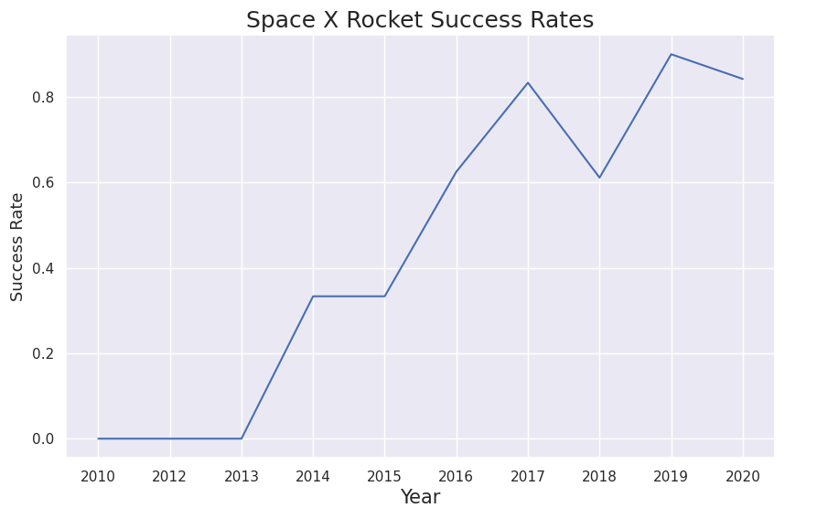
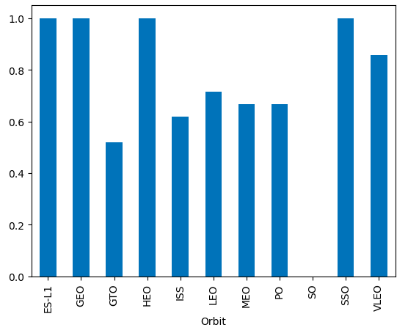
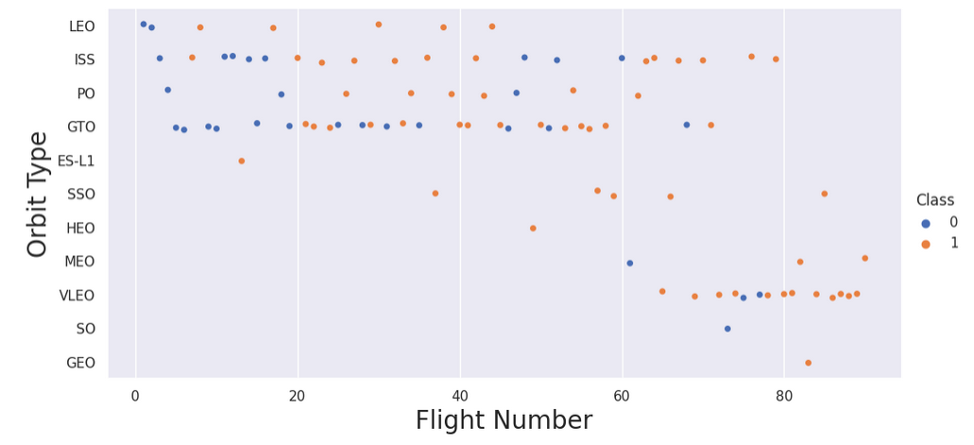
EDA with Data Visualization
We explored the data by visualizing the relationships of different values through line-, bar- and scatter point charts. We determined the success rate and launches of by orbit type, year and more.
Reference: https://github.com/BIM-Master/Space_x_IBM/blob/main/IBM-DS0321EN-SkillsNetwork_labs_module_2_jupyter-labs-eda-dataviz.ipynb.jupyterlite(1).ipynb

Slide 12
EDA with SQL
Applied EDA with SQL to acquire insights regarding data.
Our interests predominantly revolved around inquiring the;
Payload Mass & Launch site by Flight number
Flight Number, Payload & Success rate by Orbit Type
Launch Success rate by Yearly Trend.
Where the results provided us an overview where we could determine how individual Orbit types ranked juxtaposed to each other and consequently their separate success rates.

Slide 13
Build an Interactive Map with Folium
What did we do?
We added Markers for Launch Site location, successful/failed launch attempts, distance between launch sites and their varying proximities.
This information could be relevant to highlight from a visual standpoint the proximity of projects to coastal regions, highways, railways, urban centers and cities. From a Data scientist point of view this could enable stakeholders that take part of the presentation to better take into consideration locational components for future projects.
Reference: https://github.com/BIM-Master/Space_x_IBM/blob/main/IBM-DS0321EN-SkillsNetwork_labs_module_3_lab_jupyter_launch_site_location.jupyterlite(2).ipynb

Slide 14
Build a Dashboard with Plotly Dash
We built an interactive dashboard incorporating;
A Dropdown list that allows us to observe relevant Launch sites individually.
Pie Charts that highlight successful vs failed launches as a percentage of total launches.
Scatter plots that illuminate Outcomes and Payload Mass in kilograms for different booster versions.
Once again, these tools act as a visual demonstration of relevant information, However a key difference is that this time it is showcased through an interactive dashboard. The enabled agency of exploring observed data points as a stakeholder can really contribute towards communicating key insights to further organizational changes that align with the data.
Reference: https://github.com/BIM-Master/Space_x_IBM/blob/main/Spacex_dash_app(1).py

Slide 15
Predictive Analysis (Classification)
We created a Numpy Array from the Class column
After, We standardized the data utilizing Standardscalar to later fit and transform it for train & test splitting.
Then we create a GridSearchCV, with CV=10 for parameter optimization, to enhance the robustness and limit data bias.
We then apply the GridSearchCV on different algorithms
Linear Regression
Support Vector Machine
Decision Tree
K-Nearest Neighbour
We calculated the accuracy on the test data through .score(), for each Model(Algorithm), Configured a Confusion Matric for each Model(Algorithm)
Finally we can identify the best model utilizing .best_score(), to find the model that is the most accurate; where we found that the best model was a decision tree.

Slide 16
Results
Exploratory data analysis results
Launch success rate has improved over time
KSC LC-39A has the highest success rate amongst landing sites
Interactive analytics demo in screenshots
Launch sites are isolated far enough such that a failed launch won’t cause harm to local cities, highways, railways, while still close enough to access relevant infrastructure for transportation, inhabitation and so on.
Predictive analysis results
We found that the best predictive method with the highest accuracy was the decision tree.

Slide 17

Section 2

Slide 18
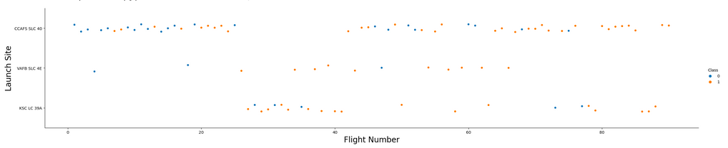
Flight Number vs. Launch Site
This scatterplot demonstrated the amount of flight numbers for respective launch site, even without a strictly numerical representation we can still see that for example CCAFS SLC 40 has more flight numbers then its competitors.

Slide 19
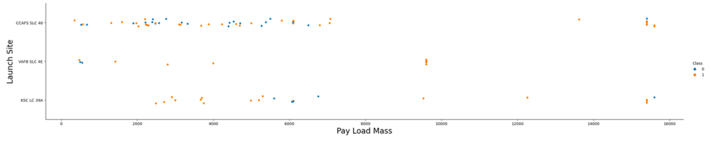
Payload vs. Launch Site
Here we observe that there is a lower mean Pay Load Mass for CCAFS SLC 40 as opposed to competitors based on number of observations. VVAFB SLC 4E and KSC LC 39A both have less observations, and by extension the presence of outliers or what we should best refer to upper quartile observations skew the mean Pay Load Mass more for them.

Slide 20
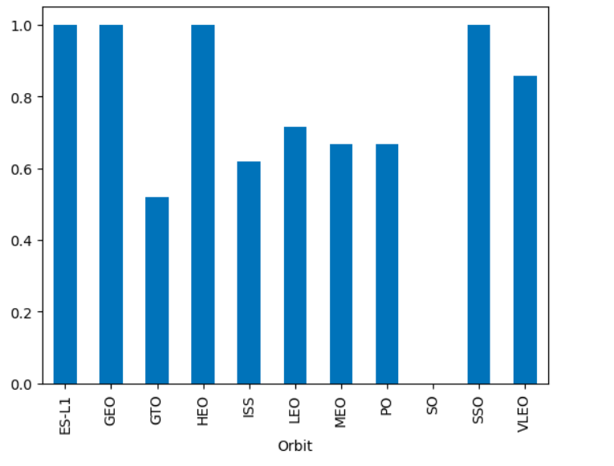
Success Rate vs. Orbit Type
Here we observe the Success Rate of each Orbit Type. We can observe that the most successful Orbit Types are, ES-L1, GEO, HEO and SSO.
The other generally observations vary between the range of circa 50-85% Success Rate, with the outlier of SO having 0% Success Rate.

Slide 21
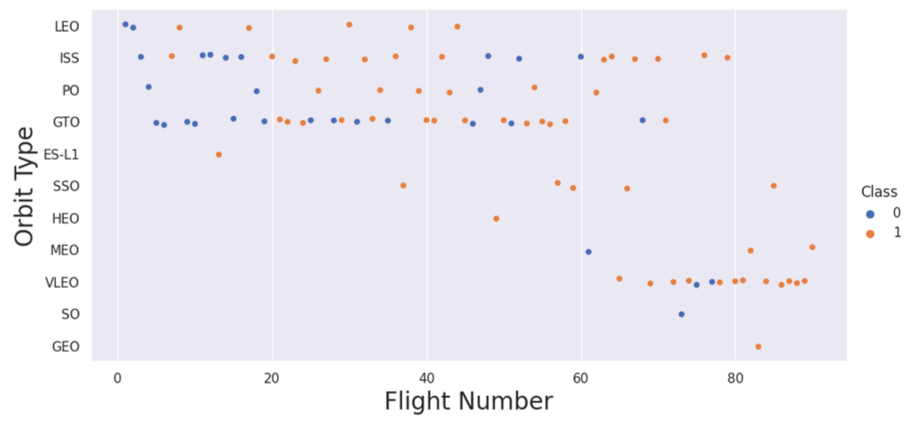
Flight Number vs. Orbit Type
Here we observe which Orbit Type has the most Flight Numbers.
The success rate typically increases with number of flights, with GTO standing out as an outlier.

Slide 22
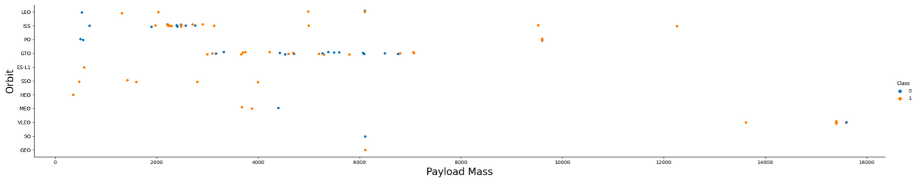
Payload vs. Orbit Type
Here we observe Pay Load Mass vs Orbit type, where we can for example observe that GTO and ISS Stand out as the subjects with most observations, and VLEO, SO and GEO with singular observations.
We also observe that there is a relation between lower Payload Mass and the number of observed orbit types.

Slide 23
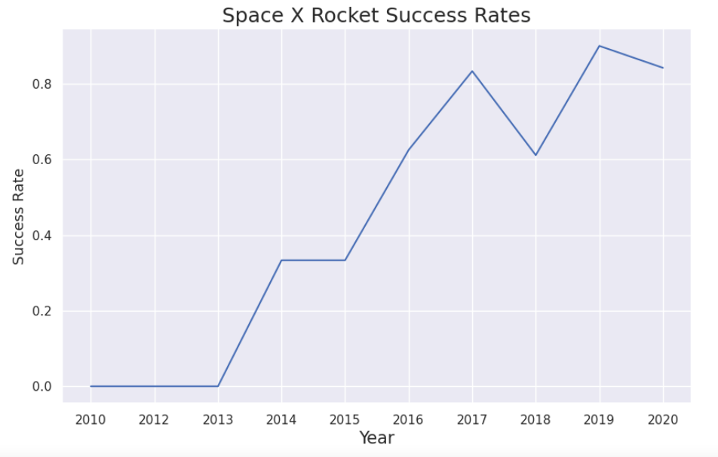
Launch Success Yearly Trend
Here we observe that Space X Rocket Success rate only starts exceeding 0% from 2013 and onwards, prominent successful time periods are 2013, 2015-2016, 2018.
And the years where the development had obstacles were 2014, 2017 and 2020.

Slide 24
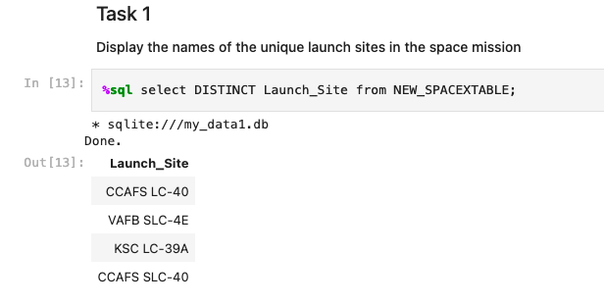
All Launch Site Names
We selected Distinct(meaning unique) Launch Sites from the Table and acquired the following result

Slide 25
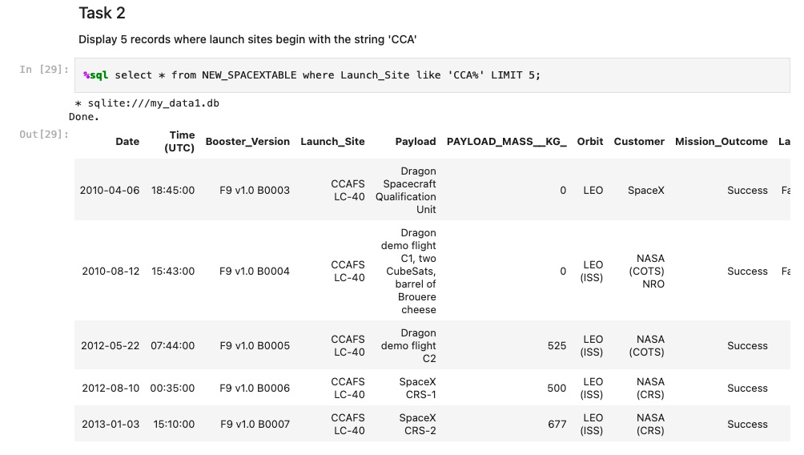
Launch Site Names Begin with 'CCA'
We selected 5 Launch Site Names starting with ‘CCA’, Utilising
Where Launch_Site like ‘CCA%’ & Limit 5

Slide 26
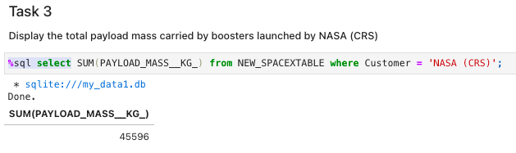
Total Payload Mass
Here we acquired the total payload mass carried by NASA (CRS) through utilizing SUM, as a means to summate the total volume;
Where Customers =‘NASA (CRS)’

Slide 27
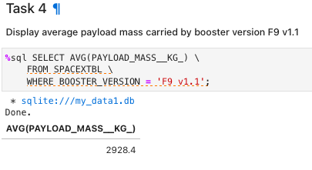
Average Payload Mass by F9 v1.1
Here we calculated the average payload mass carried by the booster version F9 v1.1 through AVG, Averaging the total observations;
Where BOOSTER_VERSION = ‘F9 v1.1’

Slide 28
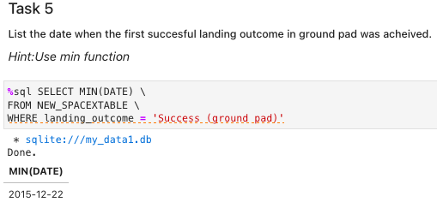
First Successful Ground Landing Date
Here we found the first successful landing outcome, by means of utilizing the MIN function. In other words, We simply ordered the code to pick the smallest numerical value in the Date column Where landing_outcome = ‘Success (ground pad)’
Our date was in a numerical value so by extension the smallest date in our record is also the earliest date observation.

Slide 29
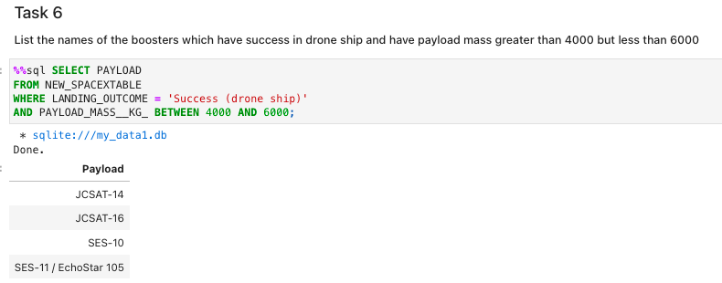
Successful Drone Ship Landing with Payload between 4000 and 6000
We listed the names of the boosters which have success in drone ship with a payload mass greater than 4000 but less than 6000.
Our Method was simply tying two commands together where we specified we wanted the landing outcome to be successful and that the payload mass was between 4000 and 6000.

Slide 30
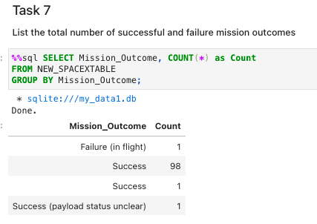
Total Number of Successful and Failure Mission Outcomes
We listed the total number of successful and failed mission outcomes by grouping the different outcomes, and then counting the instances of each outcome

Slide 31
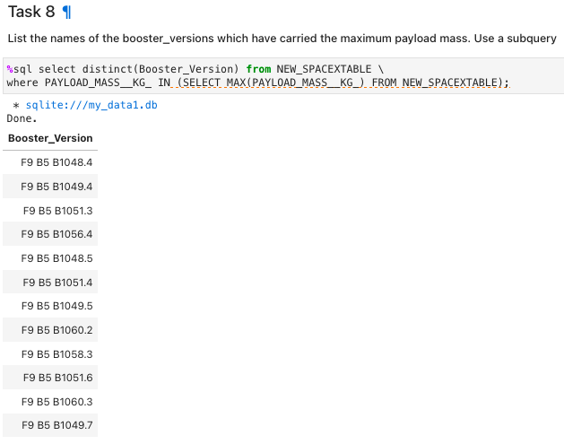
Boosters Carried Maximum Payload
Listing the names of the booster_version which have carried the maximum payload mass was enabled through using a subquery.
After specifying that we wanted distinct mentions of booster_versions we structured the subquery in a manner so we acquired the names of the booster_versions that have carried the maximum payload mass.

Slide 32
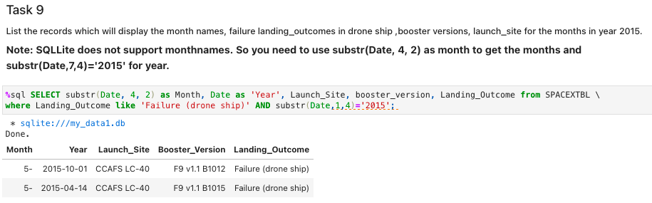
2015 Launch Records
Here is the lest of failure outcomes detailing month, year, launch site and booster_version.
We acquired this result by means of specifying our many values through ’as “name”’, where landing_outcome like ‘Failure (drone ship)’.

Slide 33
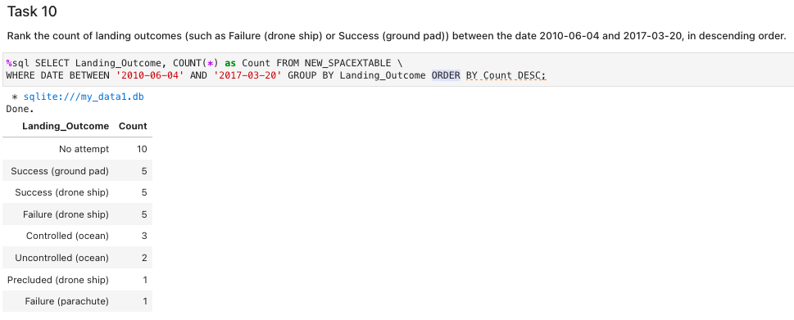
Rank Landing Outcomes Between 2010-06-04 and 2017-03-20
Rank the count of landing outcomes (such as Failure (drone ship) or Success (ground pad)) between the date 2010-06-04 and 2017-03-20, in descending order
Here we ranked the different versions of landing outcomes between the date of 2010-06-04 and 2017-03-20. As Date was Numerical, we could use the Between function and group by landing_outcome and order by Descent to reach our desired result.

Slide 34

Section 3

Slide 35
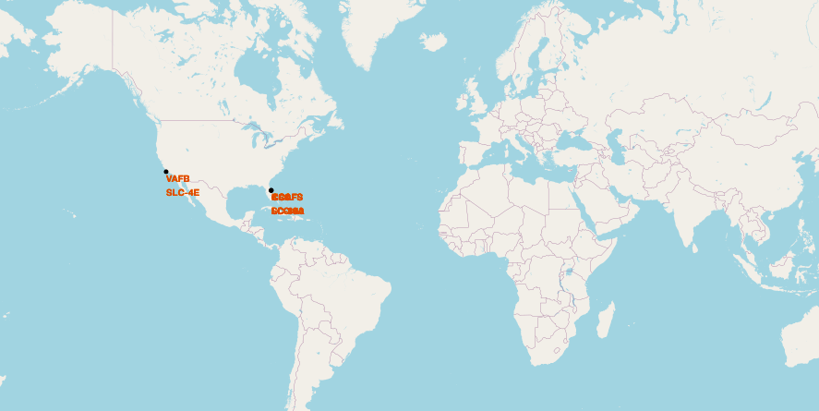
<Folium Map Screenshot 1>
We see that the Space X launch are both located in the United states, California and Florida.

Slide 36
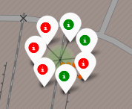
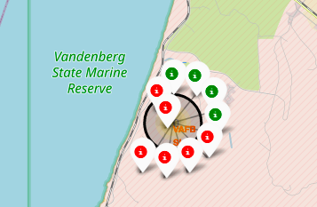
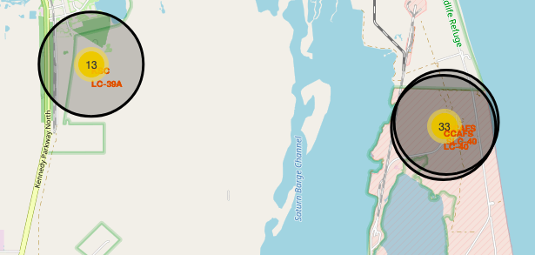
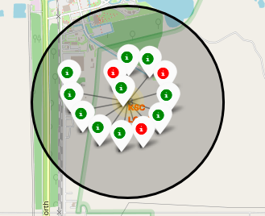
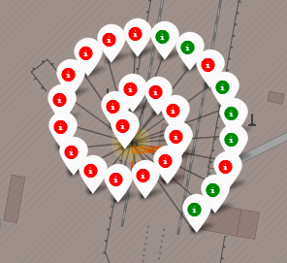
<Folium Map Screenshot 2>
Here we see that the Launch sites are highlighted from a far by a circle, by which clicking it shows each launch, with green markers showcasing successful launches and red failed ones.

Slide 37
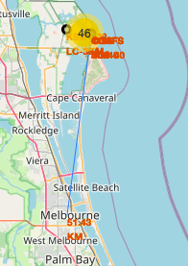
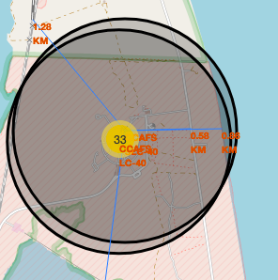
<Folium Map Screenshot 3>
Here we observe the addition of markers of distance to railway, highway, coastline, calculated in kilometers.
This allows relevant stakeholders to take into considerations the proximity to relevant infrastructure and take into consideration how this could impact the launch project.

Slide 38

Section 4

Slide 39
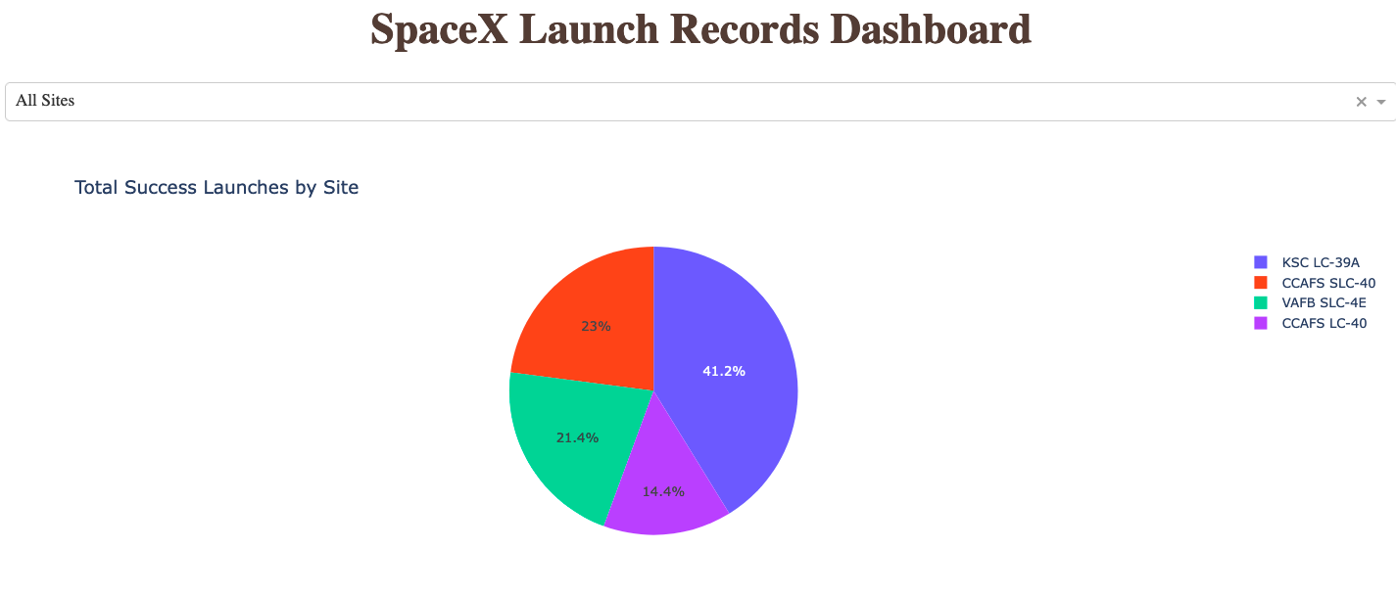
<The Piechart of Success>
Here we have a dashboard showcasing the total amount of successful launches by individual site
It is displayed through a piechart to give a better holistic oversight regarding the distribution of observations and outcomes.

Slide 40
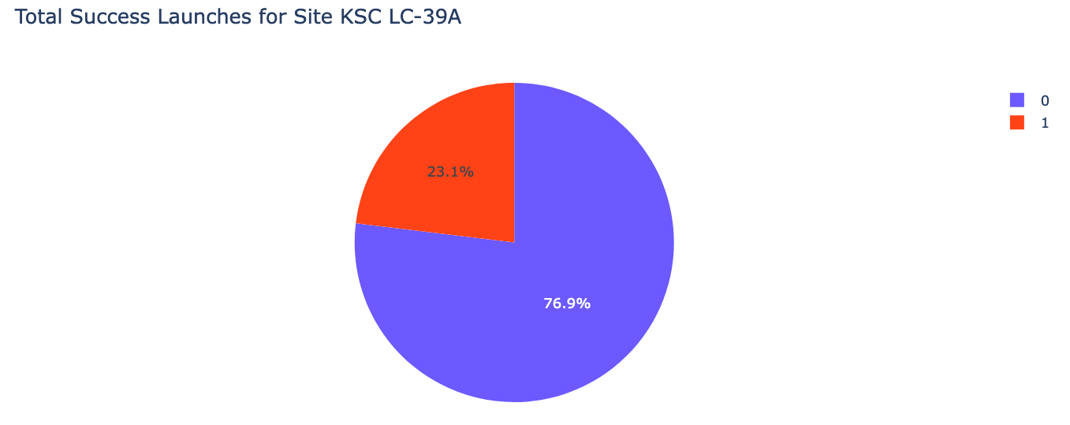
The Piechart of Success… of Success?
Following the previous slide, this image showcases the successful and failed outcomes of the best launch site, being KSC LC-39A.

Slide 41
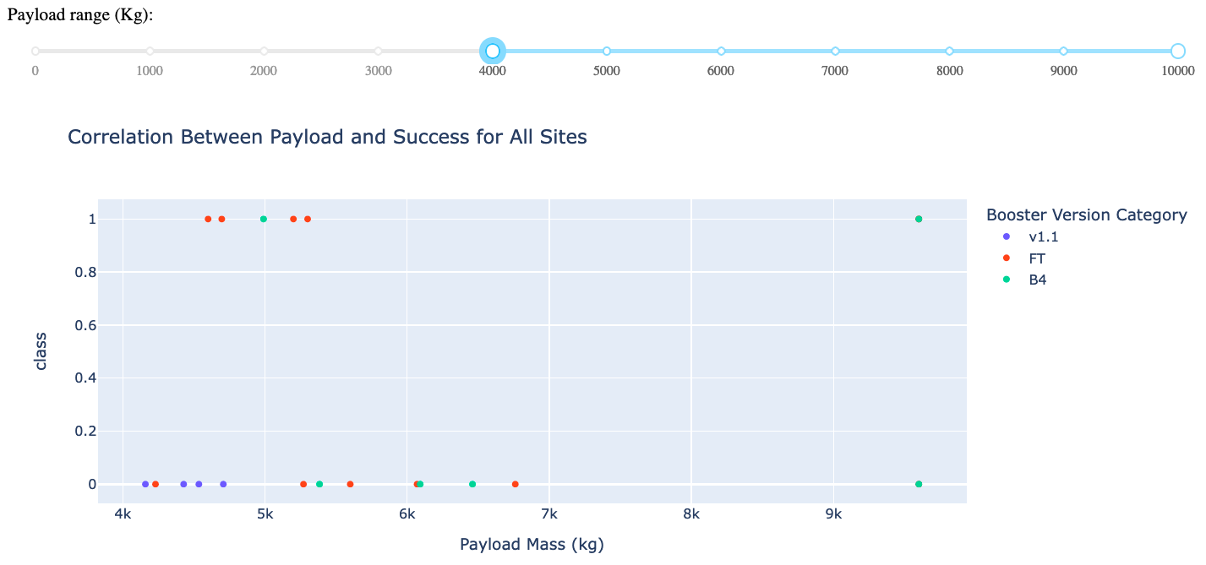
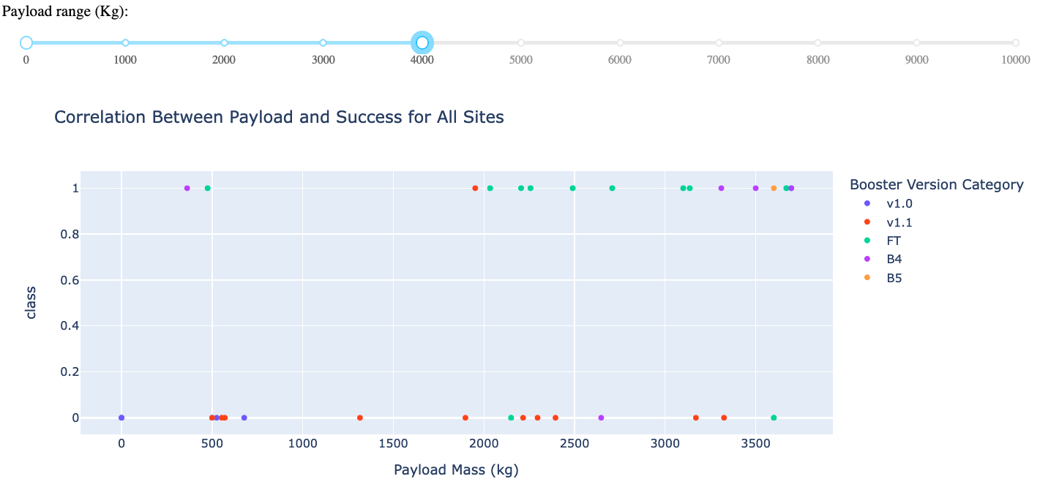
<Dashboard Screenshot 3>
Here we have two screenshots of the correlation between payload and success for all sites. We notice from observing the image of 0-4000 range and 4000-10000 range that there is a higher success rate for low weighted booster versions seen from the amount of observable outcomes in the graph.

Slide 42

Section 5

Slide 43
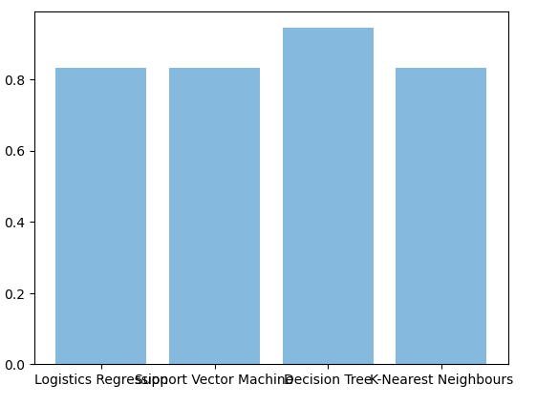
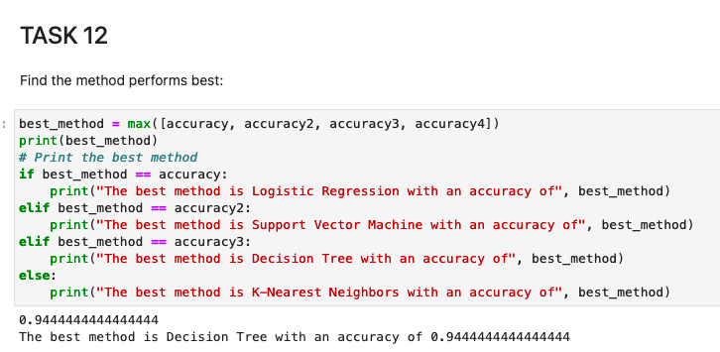
Classification Accuracy
Here we observe that the decision tree model possesses the highest classification accuracy of 0.94444. This was further demonstrated by putting the accuracy results against each other in a bar chart, visualizing the difference in scores.

Slide 44
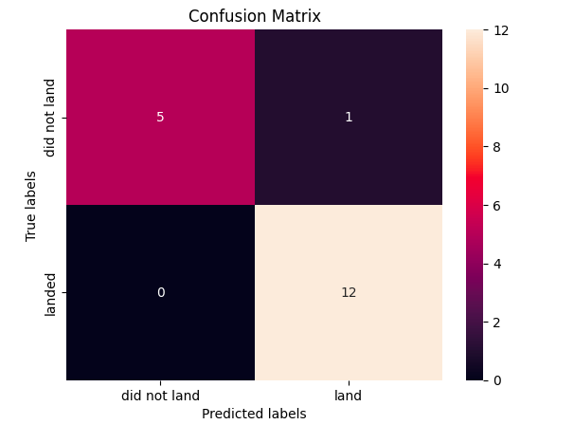
Confusion Matrix
The confusion matrix for the decision tree classifier shows that the classifier can distinguish between the different classes. The noticeable flaw of this outcome is the instance of a false positive in the top right corner, where the algorithm predicted incorrectly.
Subsequently the confusion matric outcome allows us to verify our accuracy by calculating the successful predictions vs total predictions. 5+12 were successful out of 18, meaning that the accuracy should be 17/18 = 0.94444, which is correct!

Slide 45
Conclusions
We can conclude that:
The larger the flight amount at a launch site, the greater the success rate at a launch site.
Launch success rate started to increase in 2013 with prominent successful time periods being 2013, 2015-2016, 2018.
Space X is well located in regards to surrounding infrastructure, making it both accessible for workers and material transportation yet far removed where failed outcomes would not impact nearby regions.
Orbits ES-L1, GEO, HEO, SSO, VLEO had the most success rate.
KSC LC-39A had the most successful launches of any sites.
The Decision tree classifier is the best machine learning algorithm for this task.

Slide 46

- Albin Bergström

